Slide 1
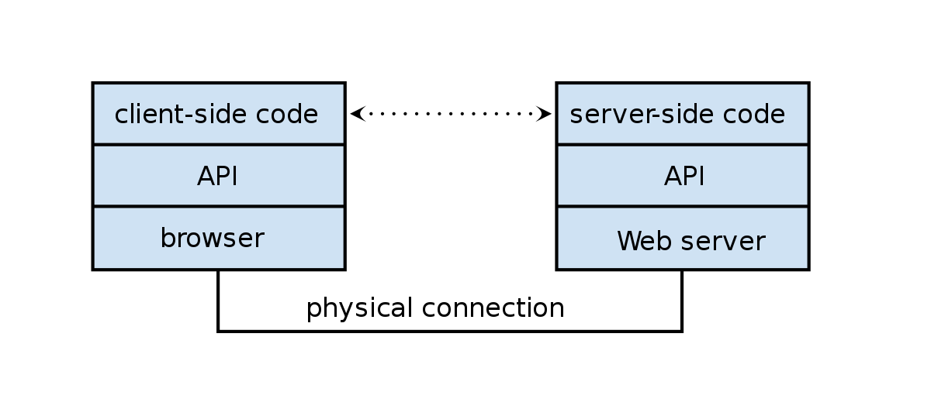
Web API Design
Frank Walsh

Slide 2
Agenda
REST
API Value
API Design
Express Middleware
Routing in Express
The Request and Response object

Slide 3

REST
Short for Representational State Transfer
Set of Principles for how web should be used
Coined by Roy Fielding
One of the HTTP creator
A set of principles that define how Web standards(HTTP and URIs) can be used.

Slide 4
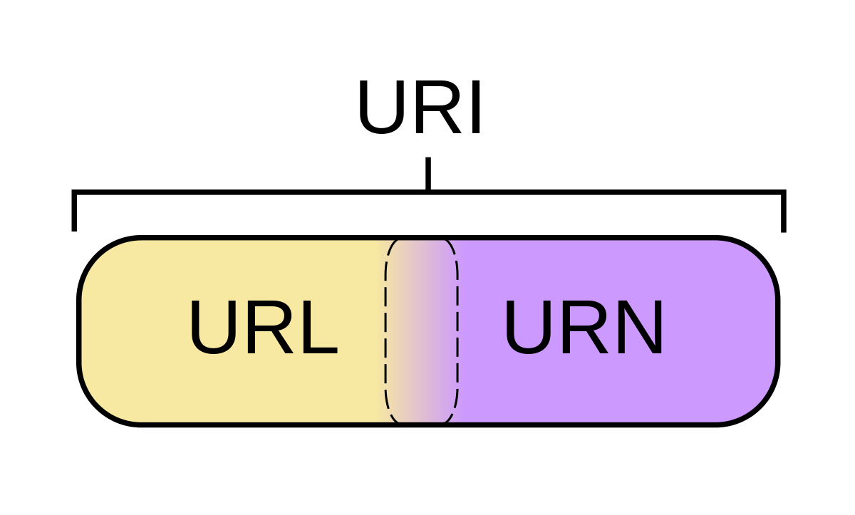
Key REST Principles
Every “thing” has an identity
URL
Link things together
Hypermedia/Hyperlinks
Use standard set of methods
HTTP GET/POST/PUT/DELETE
Manipulate resources through their representations
Resources can have multiple representations
JSON/XML/png/...
Communicate stateless
Should not depend on server state.

Slide 5
Web APIs

Slide 6
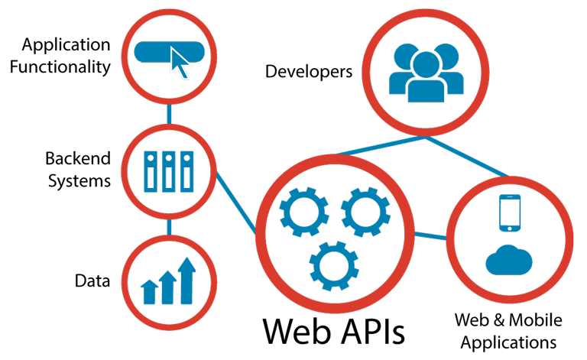
Web APIs
Programmatic interface exposed via the web
Uses open standards typically with request-response messaging.
E.g messages in JSON or XML
HTTP as transport
URIs
Example would be Restful web service described in previous lectures.
Typical use:
Expose application functionality via the web
Machine to machine communication
Distributed systems

Slide 7

“API First” approach
Collaboratively design, mockup, implement and document an API before the application or other channels that will use it even exist.
Uses “clean-room” approach.
the API is designed with little consideration for the existing IT landscape in organisation.
the API is designed as though there are no constraints.

Slide 8
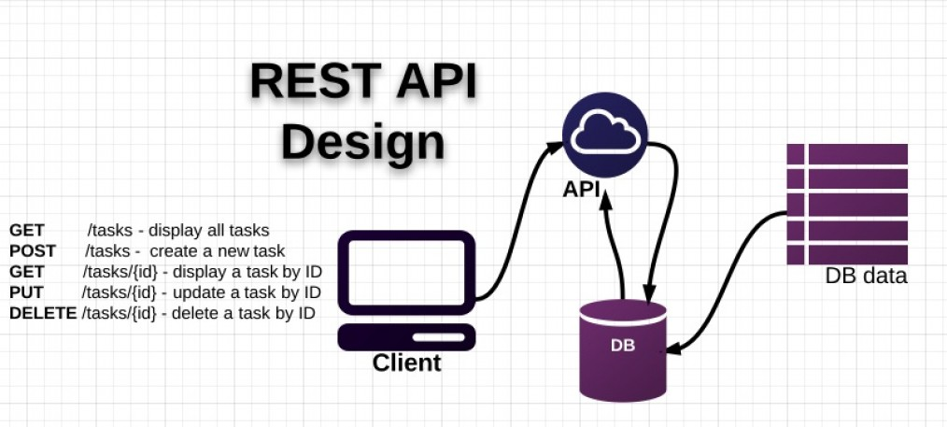
Traditional API Design
API design happens after the release of some a data-rich application
Existing application “wrapped” in API
Created as an afterthought.
Tightly bound application needs data/function exposed as API.
Shoe-horned in as a separate entity.

Slide 9
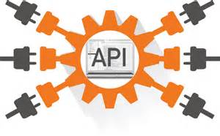
Advantages of API First
Suits multi-device environment of today.
An API layer can serve multiple channels/devices.
Mobile/tablet/IoT device
Scalable, modular, cohesive and composable
If designed properly(e.g. microservice architecture)
See later slides
Concentrate on function first rather than data

Slide 10

Example: APIs in the Internet of Things
Many new IoT devices being released.
Devices are limited on their own
It's the innovative use of those devices with accompanying APIs that generate value
"Build a better mousetrap, and the world will beat a path to your door" - Ralph Waldo Emerson
Rentokil believe they have using APIs( https://www.computerworlduk.com/it-business/rentokil-on-iot-rat-traps-cash-for-apps-incentives-apis-3612866/)
Rentokil increased operational efficiency through the automatic notifications of a caught animal and its size

Slide 11
API Design
Use principle of developer-first
put target developers’ interests ahead of other considerations
Strive for a better developer experience
Commit to RESTful APIs
Take a grammatical approach to the functionality
Keep interface simple and intuitive
Can use a Interface Description Language & Tools like:
RESTful API Markup Language (RAML)
Swagger

Slide 12
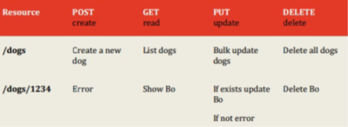
API Design
In Rest, everything is based around resources
the “things” you’re working with are modelled as resources described by URI paths--like /users, /groups, /dogs
Notice they are nouns .
Verbs in URLs are BAD
The things that you do on these things (or nouns) are characterised by the fixed set of HTTP methods
What GET,POST,PUT does is something that the designer/developer gets to put into the model.
The metadata (the adjectives) is usually encoded in HTTP headers, although sometimes in the payload.
The responses are the pre-established HTTP status codes and body. (200, 404, 500 etc.)
The representations of the resource are found inside the body of the request and response

Slide 13
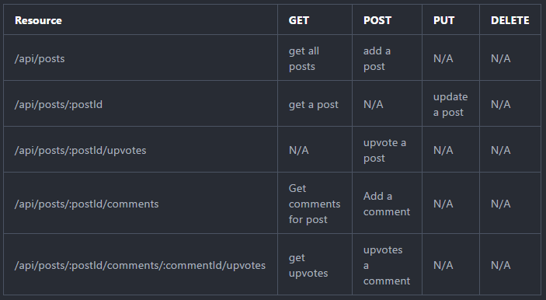
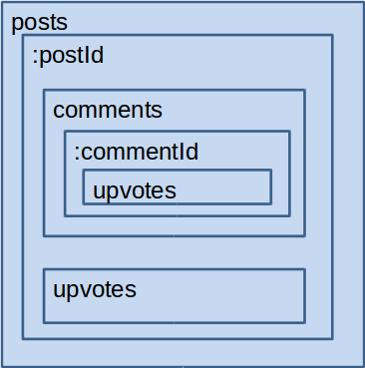
API Design - Containment
URIs embed ids of “child” resources
Post creates child resources
Put/Delete for updating /removing resources

Slide 14
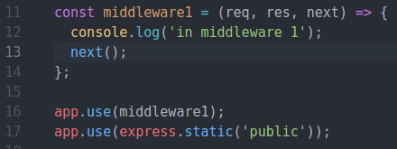
Express Middleware
Express is a Routing and Middleware framework.
You've seen the routing in the previous lab
Middleware functions have access to the Request,Response and the next() function
The next function calls the next middleware function.
Use middleware to
Change the request/response
End the request/response cycle
Call the next middleware in the stack.
If middleware does not call next() or return, express will just hang
Can be an issue with promises but can be resolved

Slide 15
Express Middleware

Slide 16
Express Middleware
Middleware functions have access to the request object (req), the response object (res), and the next middleware function in an express application’s request-response cycle.
Your express app will have a ‘stack’ of middleware functions that can
Execute any code.
Make changes to the request and the response objects.
End the request-response cycle.
Call the next middleware function in the stack.

Slide 17
Express Middleware stack
The HTTP request (also the response) passes through a pipeline/stack of middleware functions, where on each step a task is made: check request is authenticated, parse body and “inject” as an extra param in the request
Express App
HTTP Request
Authenticate
Parse Body
Main Task
http response

Slide 18

Express Middleware Types
3rd Party (e.g. body-parser)
Router level (more later)
App level (app.use(…) in last lab)
Every request is handled
Error handlers
Takes error as first parameter (err,req,res,next) => { …. }
Baked in
Express.static()

Slide 19

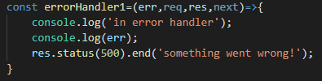
Middleware Function Signature
App level, 3rd party receive 3 arguments
Error Handling middleware receive 4 arguments(error first)

Slide 20
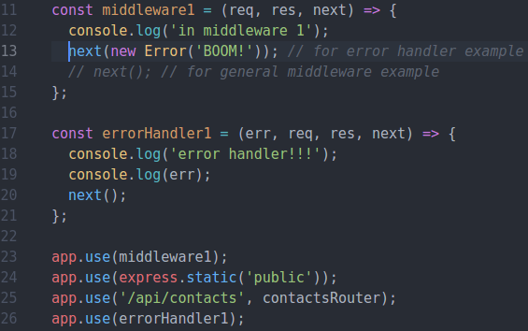
Express Middleware – Error Middleware
Raise error and pass on to next error handling middleware in middleware stack
NOTE: Middleware stack processed in the order it appears in script.

Slide 21
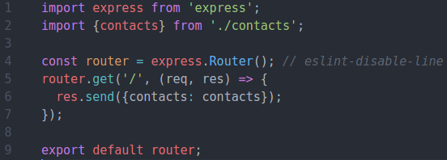
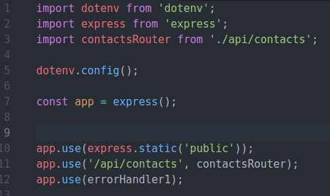
Express Routers
Exports router instance
/api/contacts/index.js (contacts router)
Can have several "routers" to implement your APIs.
Router can have its own routing and middleware
Good for multiple APIs/ versioning
Still uses the application level middleware of express app.
/index.js (express app)
Mount router to URL.
/api/contacts becomes Base Route for router

Slide 22

Express Request Object
The req object represents the HTTP request.
by convention, the object is referred to as 'req', Response is 'res'
Can use it to access the request query string, parameters, body, HTTP headers.
Example:
Parameterised URL. Access using req.params.id
Notes:
Req.Param is an abstraction layer for picking up information about a request – it automatically searches:
Query strings
Posted form values
Route values
And will let you pick from what’s available
22

Slide 23
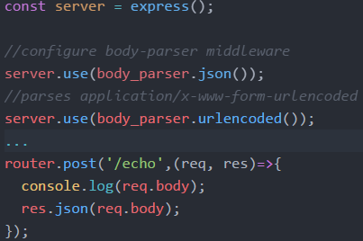
Express Request Object
req.body
Contains data submitted in the request body. ​
Need body-parsing middleware such as body-parser.​
This example shows how to use body-parsing middleware to populate req.body.​

Slide 24
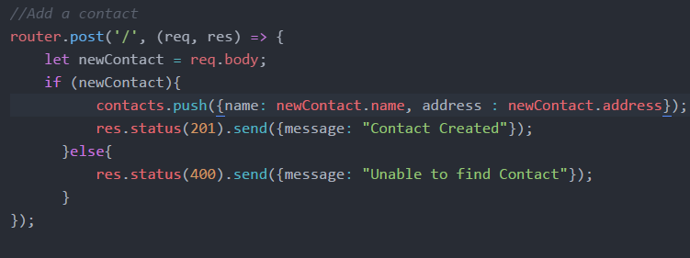
Express Response Object
The res object represents the HTTP response that an Express app sends when it gets an HTTP request.

Slide 25

Response Properties
res.send([body])
The body parameter can be a String, an object, or an Array.
For example:

Slide 26
Response Properties
res.json([body])
Sends a JSON response. This method is identical to res.send() with an object or array as the parameter. res.json({ user: 'tobi' })
res.status(500).json({ error: 'message' })

Slide 27
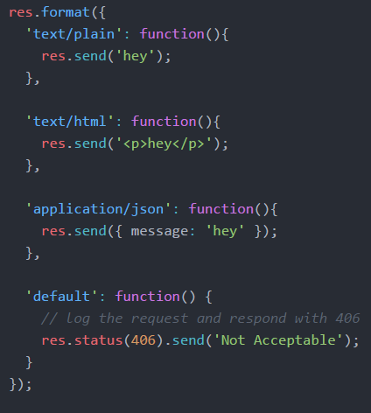
Response Properties
res.format(object)
Performs content-negotiation on the Accept HTTP header on the request object
Addresses "multiple representations" REST principle

Slide 28
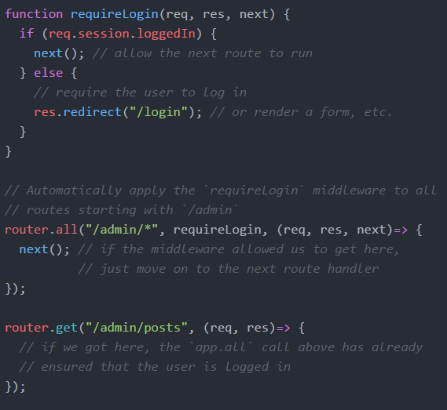
Filters
If you want to authenticate for access to resources you can use multiple callbacks built into express routing.
Multiple Callbacks

Slide 29
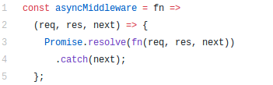
Middleware with Async await/promises
Express will not detect rejected promise automatically
Error handling middleware will not be called – causes app to hang.
Couple of ways to address this
Use try/catch in each async function/promise (lots of repetitive code)
Use a helper function that wraps our express routes to handle rejected promises.
Handy: someone has published a NPM package: npm install --save express-async-handler

Slide 30
Further Reference
ExpressJS.com - Official Express Homepage
Node and Express Tutorial

